Slide 1
Team VLISSIDES
Regan Fencl, Robert Holliday, Justin Stevenson

Slide 2
Our scenario
The scenario for our game will be set in a deep dark cave with a red dragon who is the keeper of the cave. The dragon is watcher of the large stash of gold and precious jewels. The point of the game will be for the party to traverse the cave. In the cave there are cave monsters, and minions of the dragon. The monsters are under the dragons command to keep outsiders from getting the stash of goods that are in the cave. The party, the good guys, must battle with, the bad guys, the monsters loosing life and mana for the goal of defeating the dragon and obtaining the reward of the stash of gold and the jewels.

Slide 3
Gameplay
You create a party of 3 from 6 classes: Red Mage, White Mage, Black Mage, Warrior, Thief, Monk.
You traverse the dungeon, trying to get to the Dragon to get the jewels.
You can find and equip items along the way.
You fight enemies to gain experience and level up so that you can take on the dragon.
You have abilities, all of which either attack or heal, and they can attack party-wide or a single target.
You can find potions, and use them in battle or when you’re just in the cave.

Slide 4
Our High level design
Based on Model, View, Controller.
Controller is the Game class. It mediates data between the view and the model.
It is also a façade, in that it provides a simplistic interface to the game.
The model is our character, dungeon, and battle systems.

Slide 5
Dungeon System
Manages the grid where the players and enemies interact.
Knows where the player is at in the grid.
The grid can be static or dynamic.
Does not allow the players to move outside of the grid or through a wall.
It decides when a battle occurs either via randomness or reaching set tiles, such as the dragon tile.
Tiles can have items, represent by a chest, that the player can get into their inventory.
Tiles can also be a freespace, or a wall as well.

Slide 6
Character System
Character is an abstract class. It holds data and methods that both enemy characters as well as player character need for a battle.
AbilitiesHolder is an abstract class because both players and enemies have abilities, however they are used in different ways. Players get their abilities from leveling, while enemies just get them handed to them. Players use those abilities via input. Enemies use their abilities via algorithms.
AI is handled by 3 classes. There’s striker, which attacks the lowest health player with its strongest attack. There’s Beserker, which attacks a random character. And then there is Healer Attacker, which attack White Mages, and if there is none, Red Mages.

Slide 7
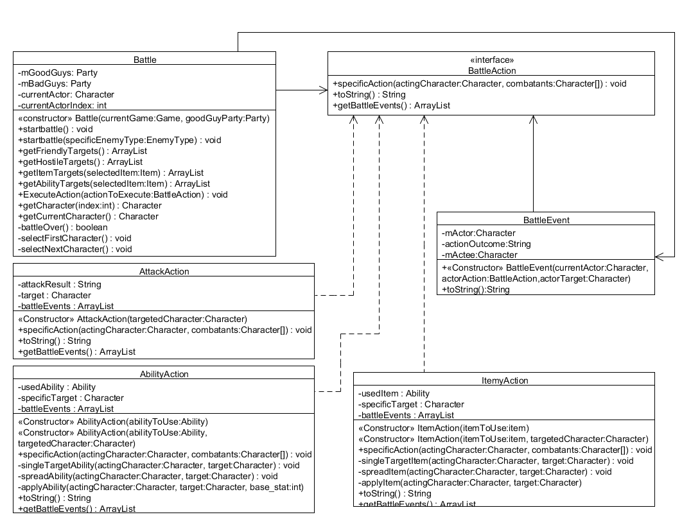
Battle System

Slide 8
Controller and View
Game controller handles all data exchange between the model and the view.
Our MVC pattern was made for text console.
View interface contains methods necessary for the whole game to work.
Text View implements these methods and handles retrieving input from the player.
These came together relatively easily.

Slide 9
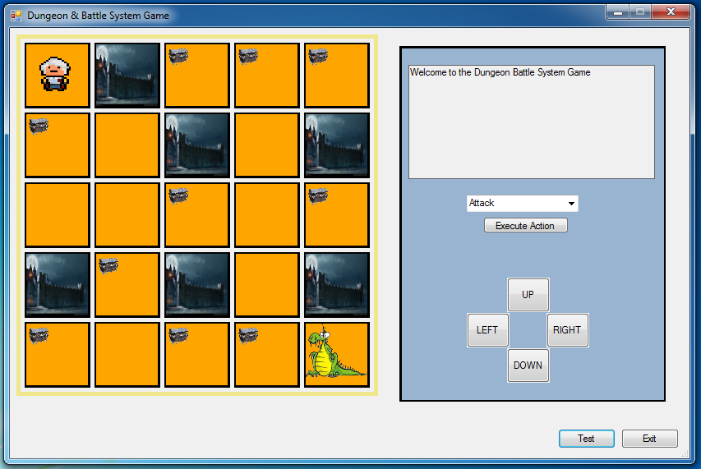
Graphical user interface
Displays the game board grid, and has text output.
Has graphical display of:
Freespaces
Walls
Items, e.g, treasure.
Uses buttons to navigate the game.
UP, DOWN, RIGHT, LEFT.
Drop down menu to execute actions.

